Slide 1
kubernetes
Lesson 03:kubernetes
Notes:
Add instructor notes here.

Slide 2
Lesson Objectives
In this lesson, you will learn:
Create Cluster
Deploy our Application
Explore our Application & expose
Notes:
Docker Platform
Docker Engine
Docker Images
Docker containers
Registry
Repositories
Docker Hub
Deploying Jar file in a Docker and push the Docker image to Repository
This lesson is to give an Introduction on Java Server Pages

Slide 3
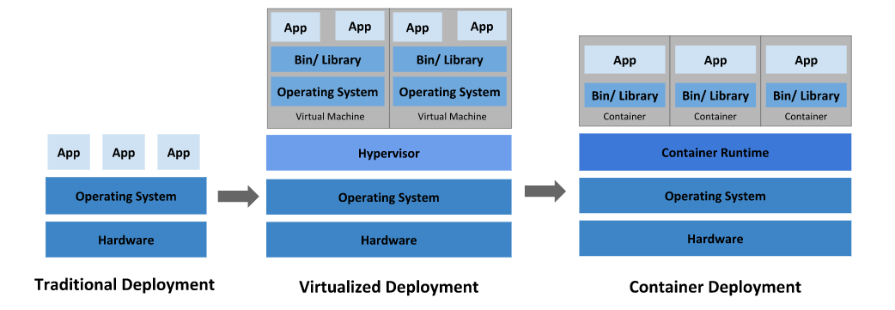
Kubernetes is a portable, extensible, open-source platform for managing containerized workloads and services, that facilitates both declarative configuration and automation.
It has a large, rapidly growing ecosystem.
Kubernetes services, support, and tools are widely available.

Slide 4
Why you need Kubernetes and what can it do
Service discovery and load balancing
Storage orchestration
Automated rollouts and rollbacks
Automatic bin packing
Self-healing
Secret and configuration management

Slide 5
There are two hooks that are exposed to Containers:
PostStart
PreStop
A handler fails for some reason, it broadcasts an event. For PostStart, this is the FailedPostStartHook event, and for PreStop, this is the FailedPreStopHook event.
apiVersion: v1
kind: Pod
metadata:
name: mypod
spec:
runtimeClassName: myclass
# ...

Slide 6
Demo-Deploy our Application

